Slide 1
Creating a Collaborative Culture: The Sequel
More ^
Effective strategies for working together to answer big questions
Michael Mandel, MBA

Slide 2
Agenda
PeopleStyles and Culture Map update
Collaboration best practices
Team Charter check-in
Building a collaboration. Literally. Again.
Coaching through breakdowns
Hosting Difficult Conversations
Wrap-up

Slide 3
This Group’s PeopleStyles
Amiable
Expressive
Analytical
Driver

Slide 4
This Group’s Culture Map
4.00
Low-Context COMMUNICATING High-Context
Direct Negative Feedback EVALUATING Indirect Negative Feedback
Principles First PERSUADING Application First
Egalitarian LEADING Hierarchical
Consensual DECIDING Top-Down
Task-Based TRUSTING Relationship-Based
Confrontational DISAGREEING Avoids Confrontation
Linear Time SCHEDULING Flexible Time
U.S. Averages

Slide 5
Collaboration Best Practices
Cultivate collective competencies/ contributions
Develop and use a work plan
Define clear roles for all members
Communicate inclusively
Produce deliverables ahead of schedule
Take notes at every meeting; conclude with action items
Practice presentations as a team
Conduct team 360° evaluations after every major deliverable
Share a common goal

Slide 6
Team Norming Conversation Starters
What do our PeopleStyles scores tell us about our communication styles?
What do our Culture Map scores tell us about our preferences around hierarchy, decision-making, conflict, and scheduling?
What strengths do we each bring to this collaboration?
How can we best leverage our strengths toward our common goals?
What commitments will we make to each other to ensure that our collaboration functions smoothly and addresses inevitable breakdowns efficiently?

Slide 7
Put it in writing
Define a clear goal for the team
Clarify and agree to expectations for team work processes and quality
Ensure each team member understands our individual impact (starting with clear roles)
Determine how we will encourage (formal or informal) socialization apart from work activities
Establish protocols to ensure no team member feels excluded

Slide 8
Building a collaboration. Literally. Again.
Your collaborative task is to build another Lego® model in 15 minutes (or less)
Using what we discussed on Monday and what you’ve learned about each other since, can you work together more efficiently to achieve your goal?
In order to beat the clock, you’ll all have to communicate clearly and trust each other

Slide 9
Ready…
Set…
Build!
1
15
14
2
13
3
12
Time’s Up!
4
11
5
10
6
9
7
8

Slide 10
How did it go this time?

Slide 11
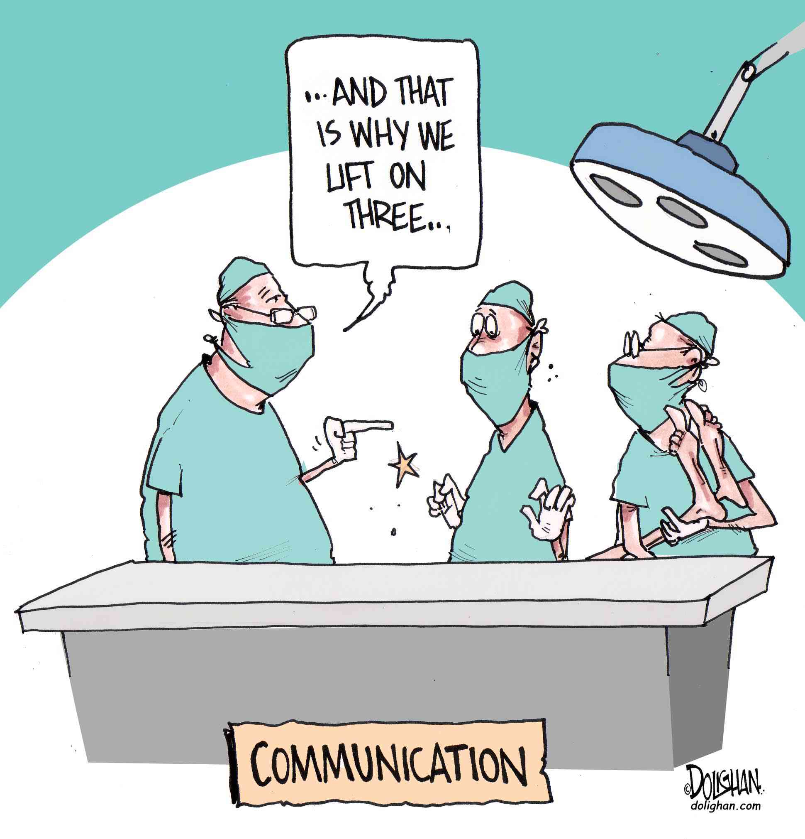
Working Through Communication Breakdowns

Slide 12
Team Charter
Breakdown
Commitment
Right/Wrong
Finger Pointing
Blame
No Coaching
Excuses/Story
Hiding/Denial
No Training
Resignation
Mind
Something is wrong with it
Something is wrong with them
Something is wrong with me
Conversation for Action
Requests & Commitments
Conversation for Opportunity
Evaluate the Possibilities
Declare a Breakdown
Restate Commitment
Conversation for Possibility
Brainstorming
Communicate
Resolve
Be Responsible
Still Committed?
No
Yes

Slide 13

Difficult Conversations
Host the Three Conversations
What happened?
Feelings
Identity
Articulate the Third Story
Listen to Understand
Share Your Viewpoint
Find a Resolution
Reframe, Reframe, Reframe

Slide 14
Wrap-up
PeopleStyles and Culture Map update
Collaboration best practices
Team Charter check-in
Building a collaboration. Literally. Again.
Coaching through breakdowns
Difficult Conversations

